Slide 1
Operational Risk
Chapter 20

Slide 2
Definition of Operational Risk
“Operational risk is the risk of loss resulting from inadequate or failed internal processes, people, and systems, or from external events”
Basel Committee Jan 2001

Slide 3
What It Includes
The definition includes people risks, technology and processing risks, physical risks, legal risks, etc
The definition excludes reputation risk and strategic risk

Slide 4
The Biggest Risk?
Operational risk is difficult to quantify but is now regarded as the biggest risk facing banks
Cyber risk is a huge issue flor financial institutions
Compliance risks can lead to huge losses (e.g. BNP Paribas’s $9 billion loss in 2014)

Slide 5
Categories of Operational Risk
Internal fraud
External fraud
Employment practices and workplace safety
Clients, products and business practices
Damage to physical assets
Business disruption and system failures
Execution, delivery, and process management

Slide 6
Loss Severity vs Loss Frequency (Section 20.3)
Loss frequency should be estimated from the banks own data as far as possible. One possibility is to assume a Poisson distribution so that we need only estimate an average loss frequency. Probability of n events in time T is then
Loss severity can be based on internal and external historical data. One possibility is to assume a lognormal distribution so that we need only estimate the mean and SD of losses.

Slide 7
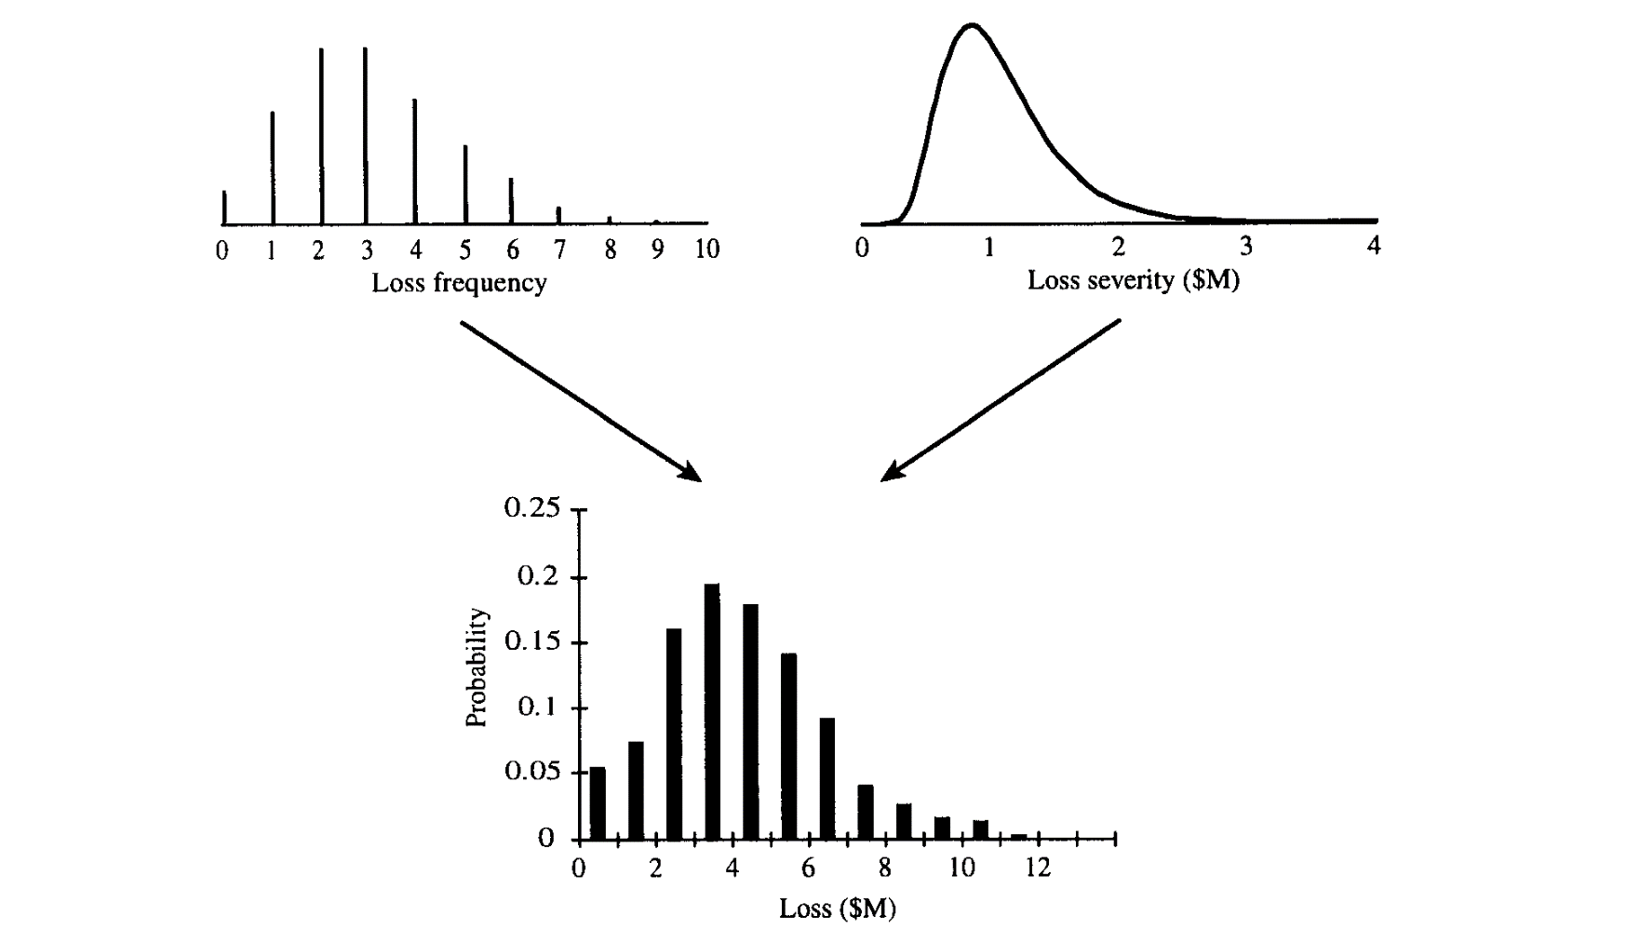
Using Monte Carlo to combine the Distributions (Figure 20.1)

Slide 8
Monte Carlo Simulation Trial
Sample from frequency distribution to determine the number of loss events (=n)
Sample n times from the loss severity distribution to determine the loss severity for each loss event
Sum loss severities to determine total loss

Slide 9
SMA
Bank regulators now calculate capital for operational risk using the Standard Measurement Approach (SMA)

Slide 10
SMA: The Business Indicator (BI)
The business indicator (BI) reflects net interest income, other operating income, the net P&L (see Section 20.4)
BI Component (BIC) is a piecewise linear function of BI (see Table 20.1)

Slide 11
SMA: The Loss Component
The Loss Component (LC) is equal to the 15 times the average annual operational research losses over the previous 10 years.
If 10 years of losses are not available banks can use losses over 5 years during a transition period

Slide 12
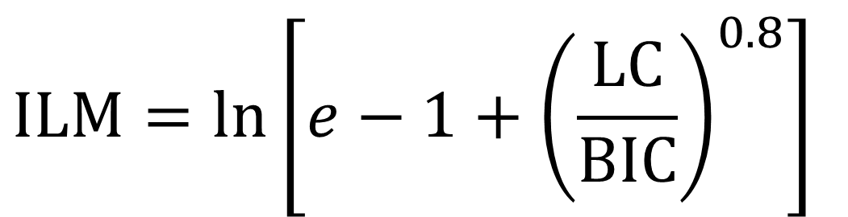
SMA: The Internal Loss Multiplier (ILM)
$$\text{ILM}=ln\left[e−1+{\left(\frac{LC}{BIC}\right)}^{0.8}\right]$$

Slide 13
SMA Capital
The capital is set equal to BIC for small banks and the product of BIC and ILM for large banks
National regulators have some discretion

Slide 14
Loss Prevention
Establish causal relationships
RCSA
KRI
Allocate operational risk capital to encourage business units to reduce operational risk
Educate employees to be careful about what they write in emails and (when they work in the trading room) what they say over the phone

Slide 15
Power Law
Prob (v > x) = Kx^{-α}
Research shows that this works quite well for operational risk losses
Distribution with heaviest tails (lowest α) tend to define the 99.9% worst case result

Slide 16
Insurance (Section 20.8)
Factors that affect the design of an insurance contract
  Moral hazard
  Adverse selection
To take account of these factors there are
  deductibles
  co-insurance provisions
  policy limits

Slide 17
Sarbanes-Oxley (Section 20.9)
CEO and CFO are more accountable
SEC has more powers
Auditors are not allowed to carry out significant non-audit tasks
Audit committee of board must be made aware of alternative accounting treatments
CEO and CFO must return bonuses in the event financial statements are restated

